Slide 1
Modeling Invasive Carp Passage Risk in the Mississippi River
Caleb Bush 1/20/26

Slide 2
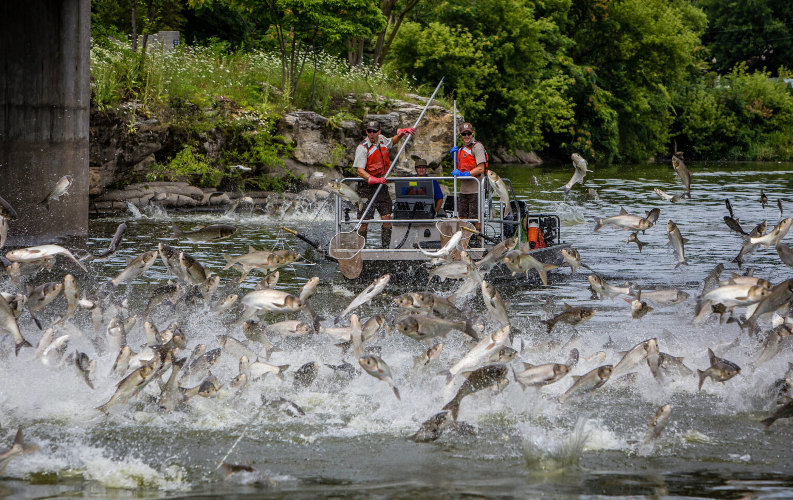
Project Idea Background
Carp were introduced in the 1970’s
Outcompete native fish
Degrades habitats
Use the Mississippi as a highway for expansion

Slide 3
Project Problem Solution
Use environmental data to identify high risk conditions for carp movement
Develop models that link carp movement to river and lock conditions
Map out high activity spots of invasive carp activity
Predict when and where upstream movement is most likely to occur

Slide 4
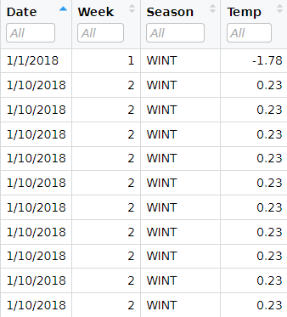
The Dataset
Data is from 2017-2018 obtained by the U.S. Army Corps of Engineers and distributed by ScienceBase
The study location was the Mississippi River at Lock and Dam 19 near Keokuk, Iowa
Some key features surrounding fish level attributes are species, length, and weight
Predictive features include season, water temperature, and passage indicators

Slide 5
Models
Spatial Modeling
Identify where and when is carp activity the highest
Risk Modeling
Assess environmental conditions that create upstream passage risk
Random Forest
Determine which variables are most impactful in predicting carp movement

Slide 6
Conclusion
Invasive carp movement risk varies across time and area
Environmental and human factors influence upstream passage risk
Predictive models can provide actionable insights for management

